Slide 1
Some useful programing tips

Slide 2
Project artifacts

Slide 3
Main artifact
Find in project folder the exe file
Build in release mode

Slide 4
Clean project
Build > Clean project
Show all hidden files & folders
Find .vs folder

Slide 5
Overload

Slide 6
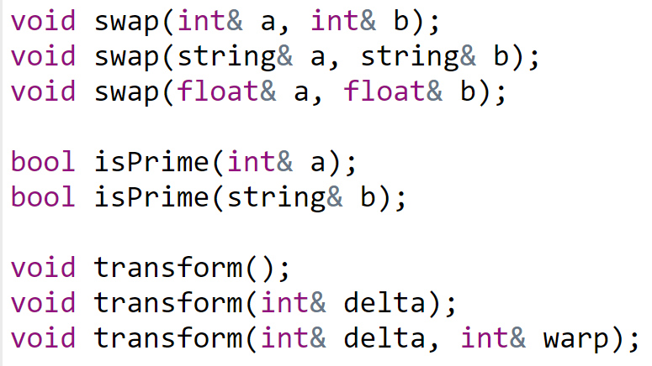
Overload
Functions that has the same name, different arguments

Slide 7
Struct

Slide 8
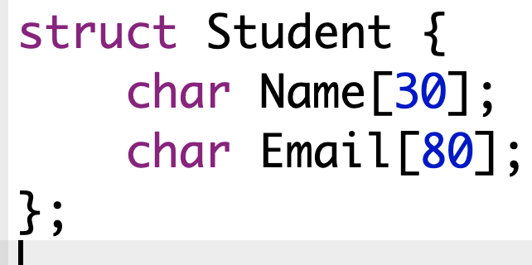
Struct definition

Slide 9
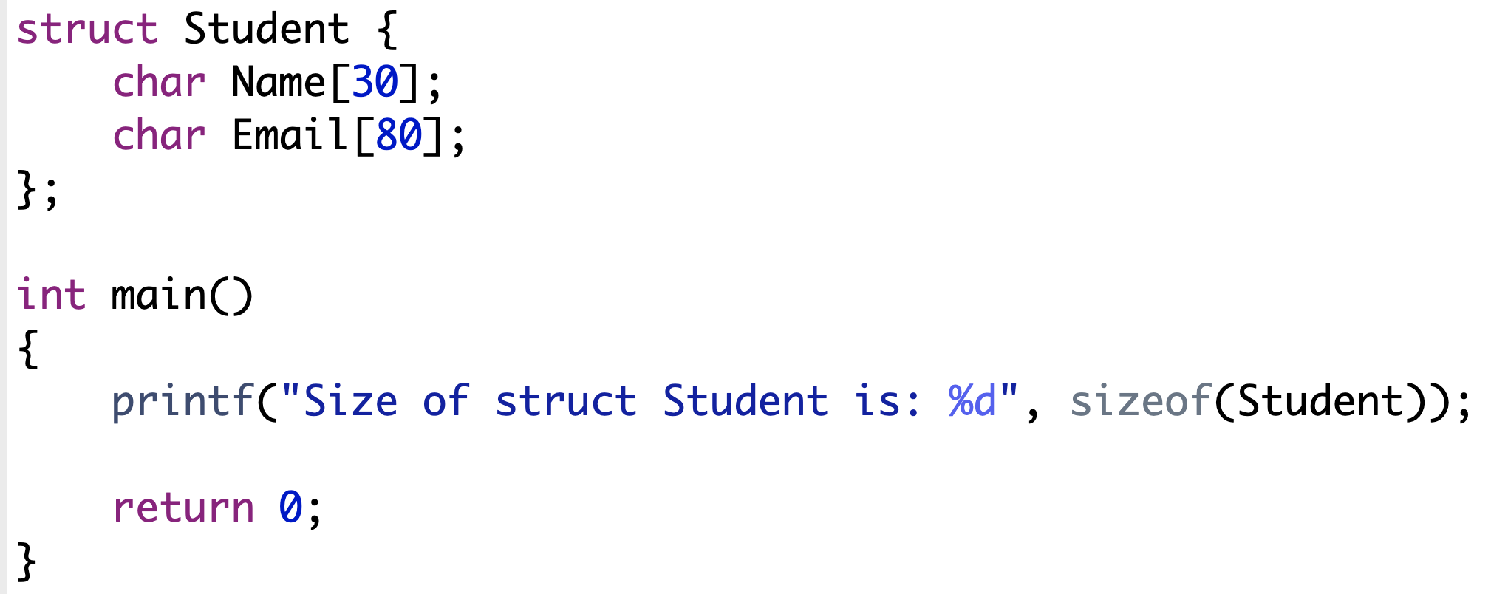
Struct size
Size is 110, why?

Slide 10
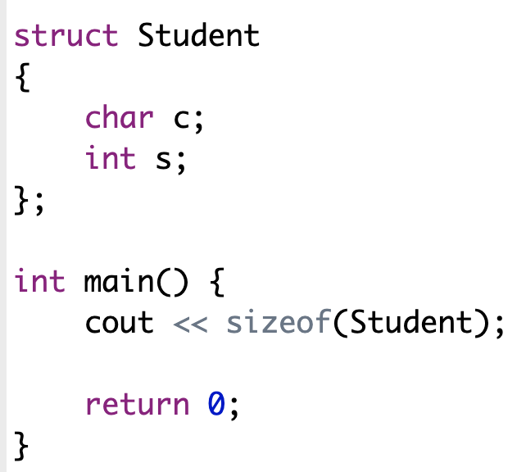
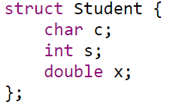
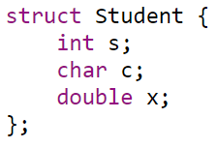
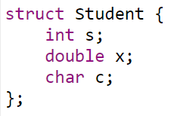
How about this?
16 16 24
https://cppdeveloper.com/c-nang-cao/data-alignment-trong-c-c/

Slide 11
Pointer

Slide 12
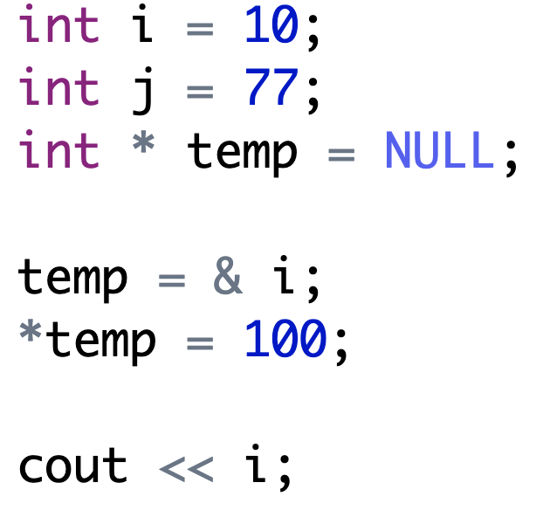
Pointer basic
Pointer is a variable that stores address of another variable

Slide 13
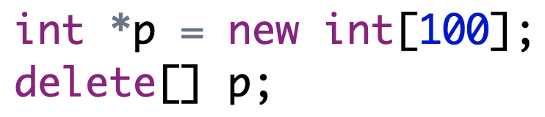
Allocation & deallocation

Slide 14
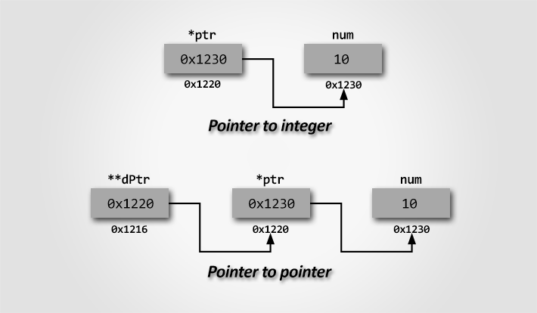
Pointer to a pointer
Image from https://codeforwin.org/2017/12/pointer-programming-exercises-and-solutions-in-c.htm

Slide 15
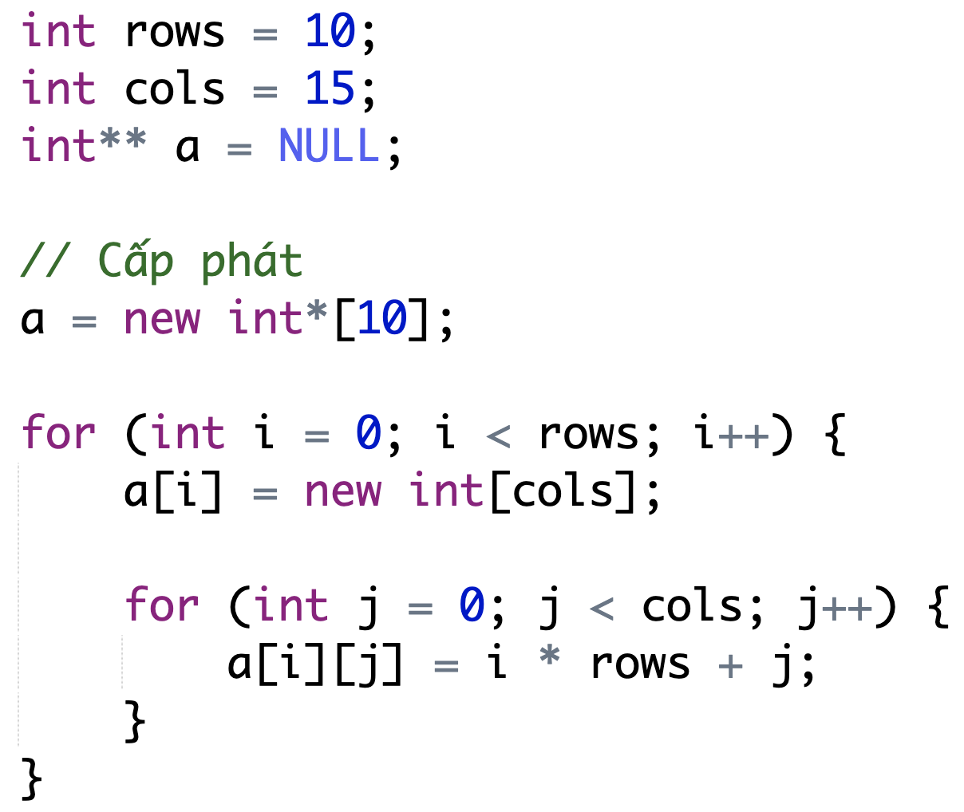
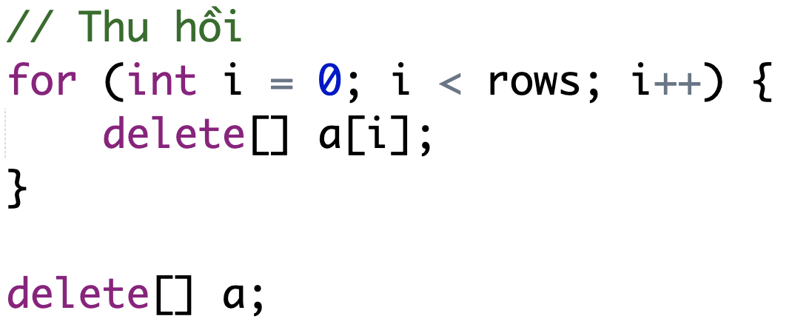
Two dimensions allocation & deallocation

Slide 16
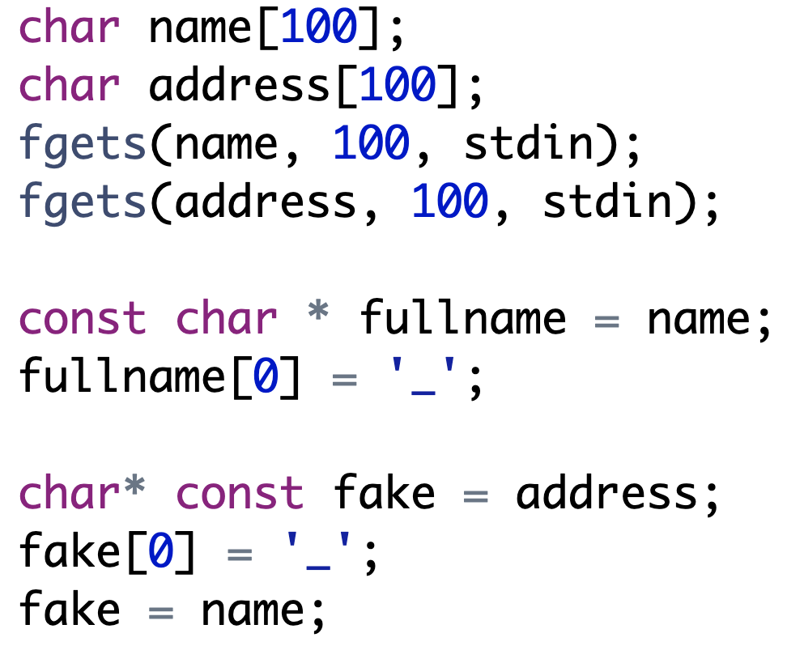


const char * vs const * char
Rule: outside const prevent inside change & vice versa

Slide 17
Function pointer

Slide 18

Simple explanation for function pointer
Public way to work with other components
Let’s take a projector for example
If there is a device connected to the projector, it will project the images that it received
If not, nothing will happen

Slide 19
Declaration syntax
int* foo (int); // Normal function prototype, not a function pointer
int (*foo)(int);
int* (*foo)(int);

Slide 20
Exercise – Which one is function pointer?
1. bool checkPrime(int);
2. bool *checkPrime(int);
3. bool (*checkPrime)(int);
4. void (*getAllStudents)();
5. void *updateStudentById(int id);

Slide 21
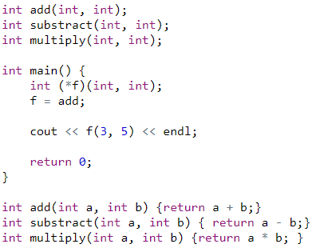
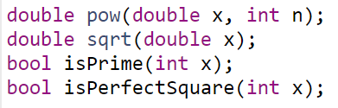
Usage
Which of the following functions can be pointed to by f?

Slide 22
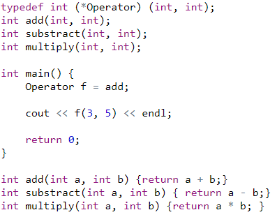
Better way - Turn it into a type

Slide 23
Example of function pointer
Write a sorting function of an int array
The order of sorting (ascending or descending) can be decided by an external function through function pointer

Slide 24
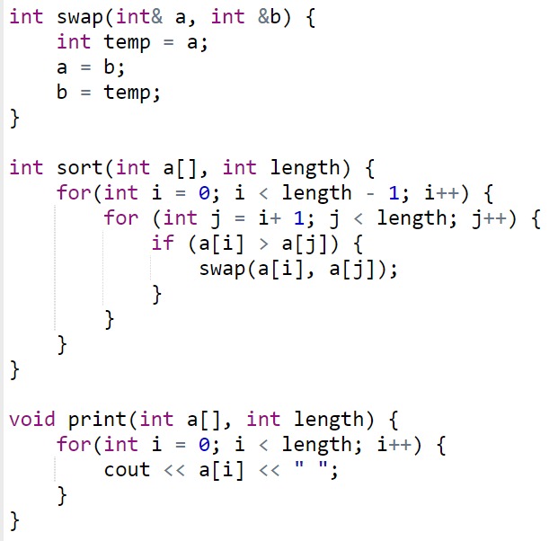
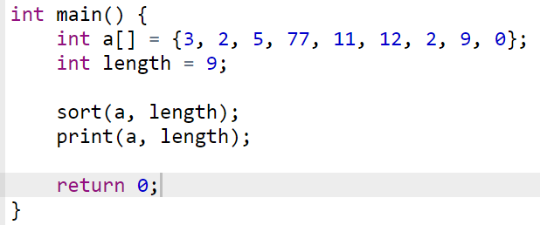

Normal implementation for soring array
How about descending order?

Slide 25
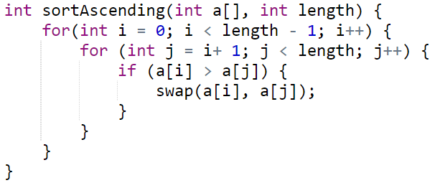
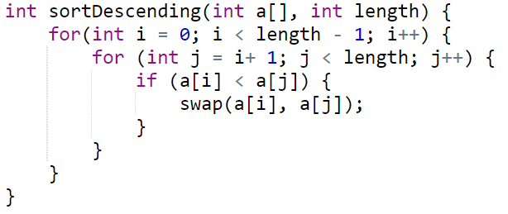


Sorting ascending & descending

Slide 26
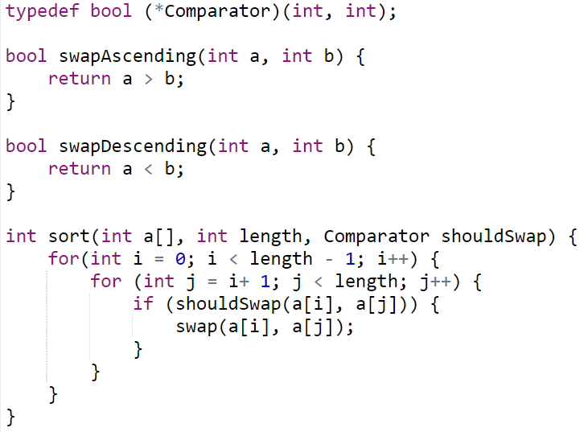
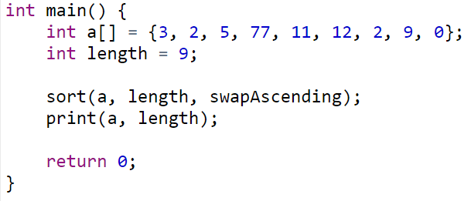
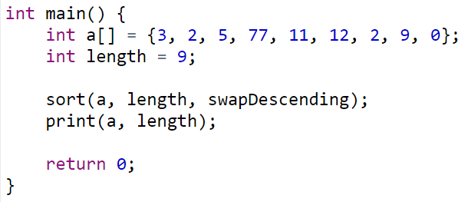
Using function pointer

Slide 27
Function call stack
Notes:
https://softwareengineering.stackexchange.com/questions/195385/understanding-stack-frame-of-function-call-in-c-c

Slide 28
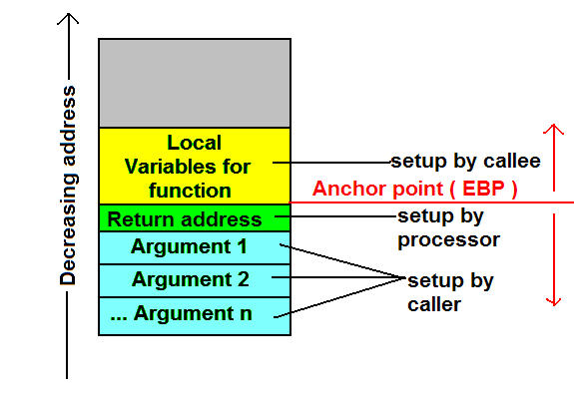
Stack content – What happens in function calls?
https://stackoverflow.com/questions/23981391/how-exactly-does-the-callstack-work

Slide 29
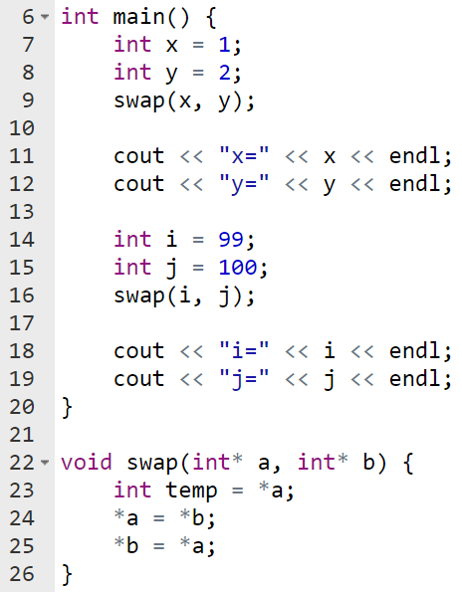

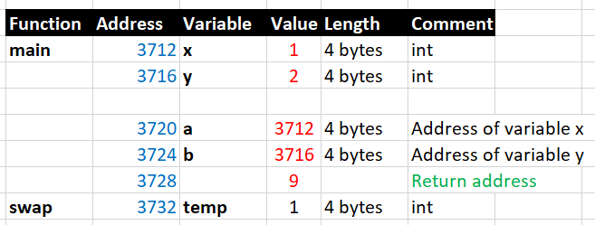
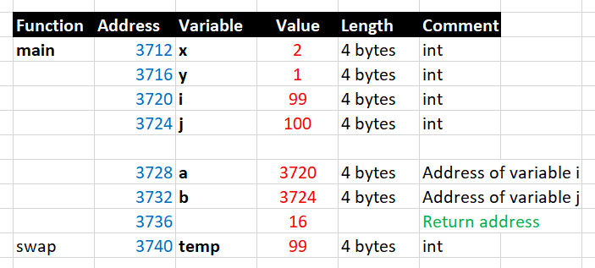

Function call stack example (POC)
For POC purpose, the return address is the code’s line number

Slide 30
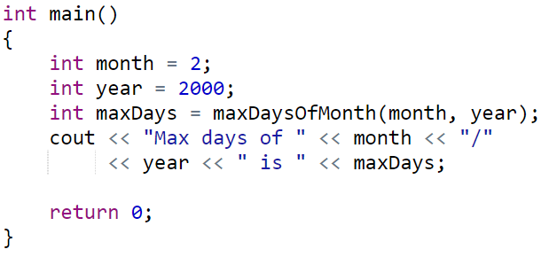
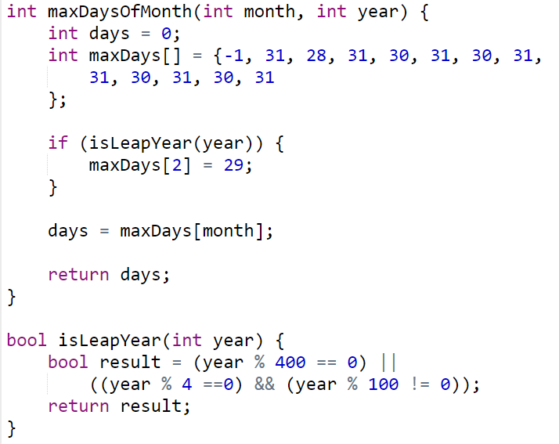
Exercise – Try to explain function call stack

Slide 31
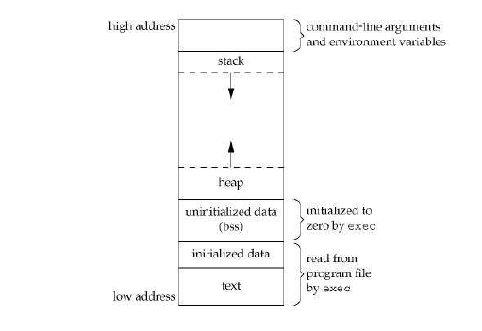
Location of global variables

Slide 32
Pass by value & reference

Slide 33
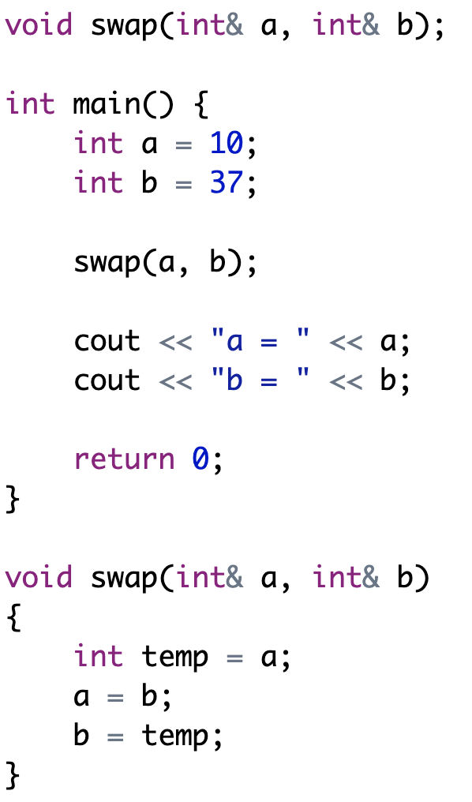
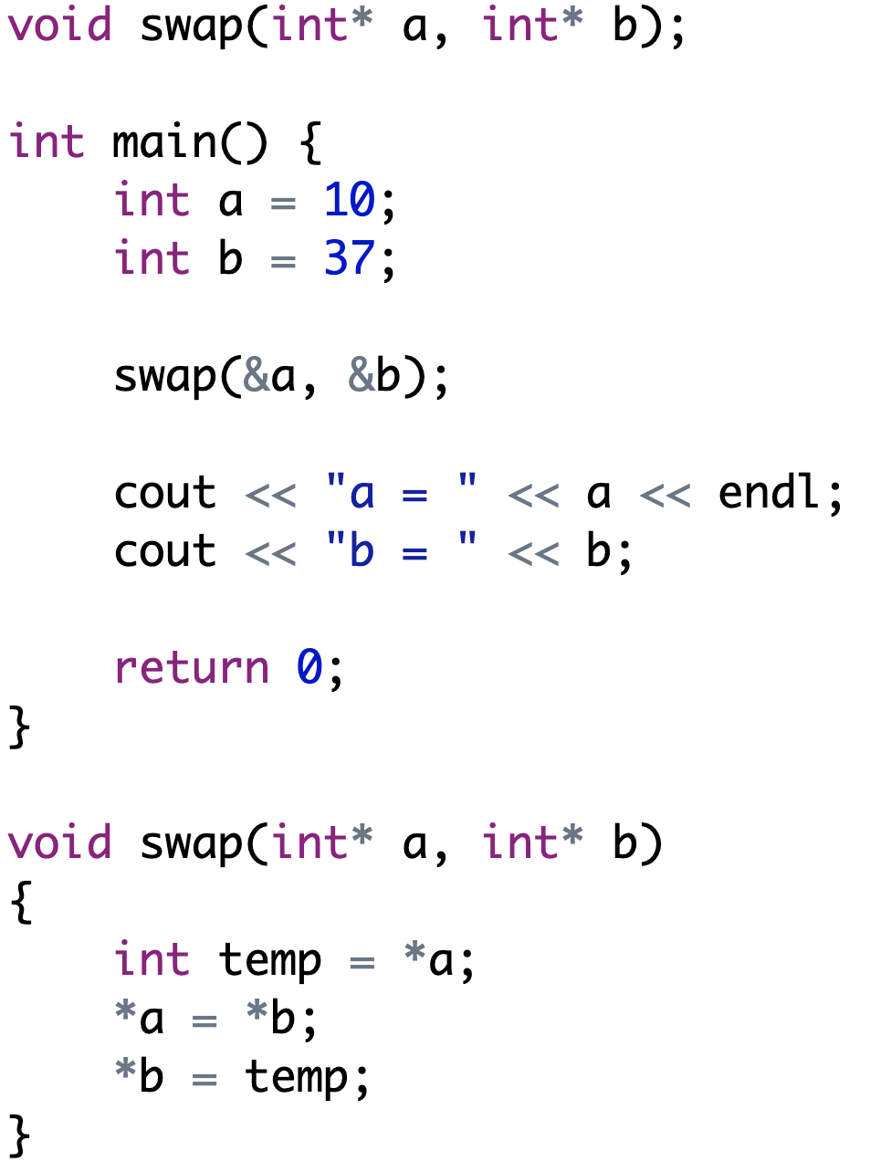
Swap two values of two integers

Slide 34
Key take away
Pass by value: a clone copy of the argument
Pass by reference using pointer arguments
Pass by reference using reference arguments
A reference is an alias, or an alternate name to an existing variable, no memory allocation is needed
https://www3.ntu.edu.sg/home/ehchua/programming/cpp/cp4_PointerReference.html

Slide 35
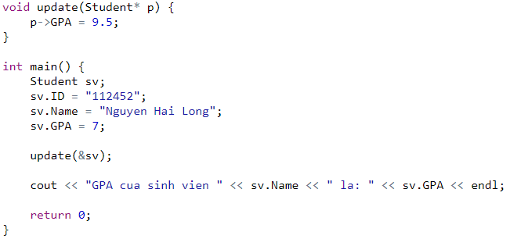
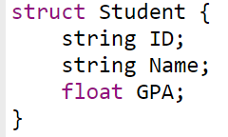
Exercise – Explain why student’s GPA changes?
Write a function that alter student’s data
Will the GPA be changed after the call? What if in update function, p is type of Student / Student& ?

Slide 36
Random number generator

Slide 37
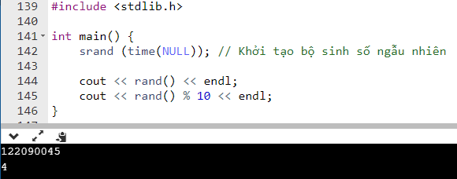
Random number generator - C style

Slide 38
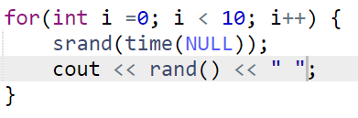
Generate multiple random numbers
What is the problem here?
Random sequence is not truly random, determined by initial value, called seed
The above code use current time as seed

Slide 39
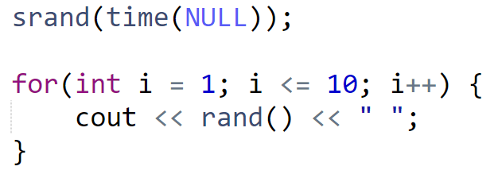
Solving seeding problem
The seeding should only happen once

Slide 40
Exercise – Implement these functions
int nextInt(int ceiling)
Generate a random int from 0 to ceiling – 1
int nextInt(int from, int to)
Generate a random int in the range of [from, to]
float nextFloat()
Generate a random float

Slide 41
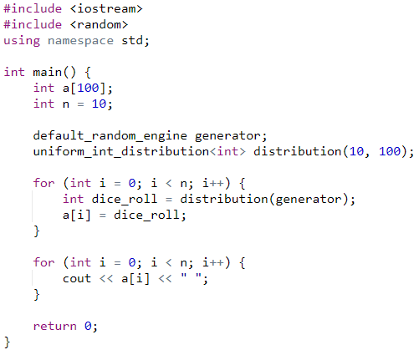
Random number generator - C++ style

Slide 42
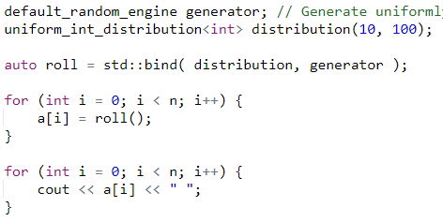
Functional style

Slide 43
string

Slide 44
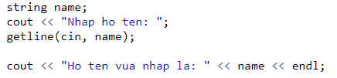
Get value of a string & display

Slide 45
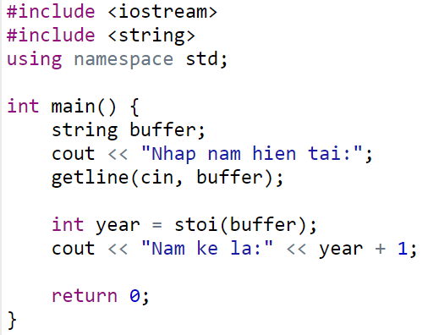

Convert a string into number
stoi
stof

Slide 46
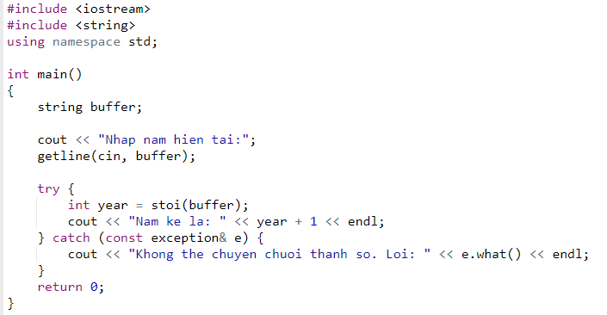
Exception handling

Slide 47
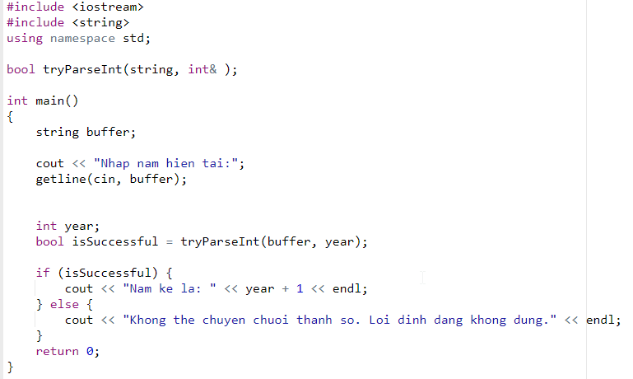
tryParseInt

Slide 48
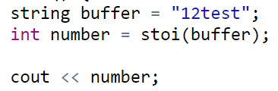
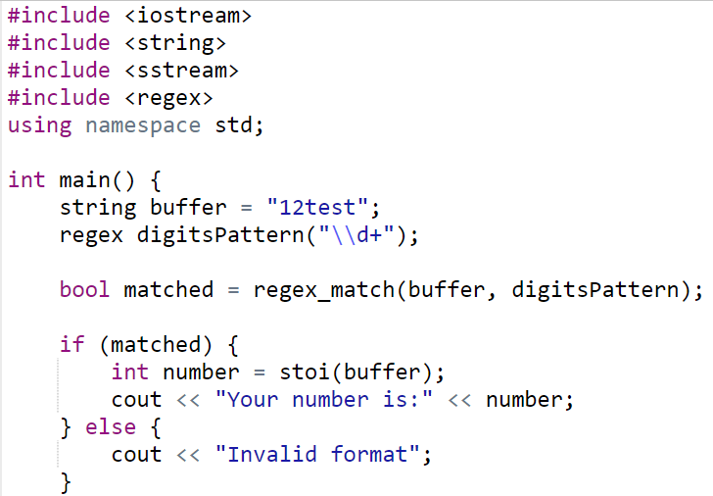


Number patterns using Regular Expression

Slide 49
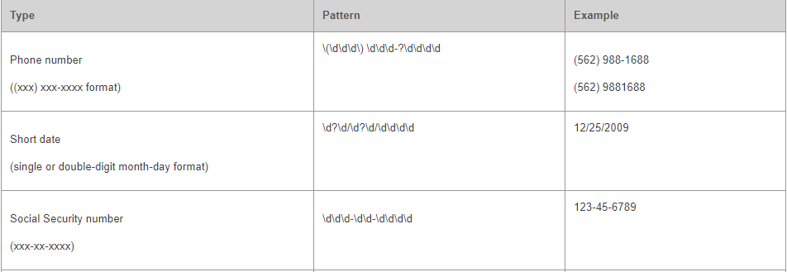

Other common regular expression patterns

Slide 50
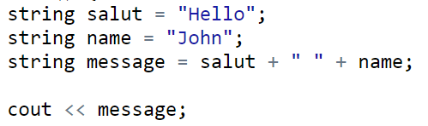

Combine multiple strings – First way – Operator +
Problem? Unnecessary temporary values & extra computation

Slide 51
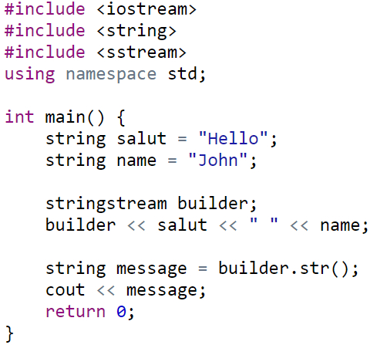
Combine multiple string – Second way - StringStream
Final string only created when needed!

Slide 52
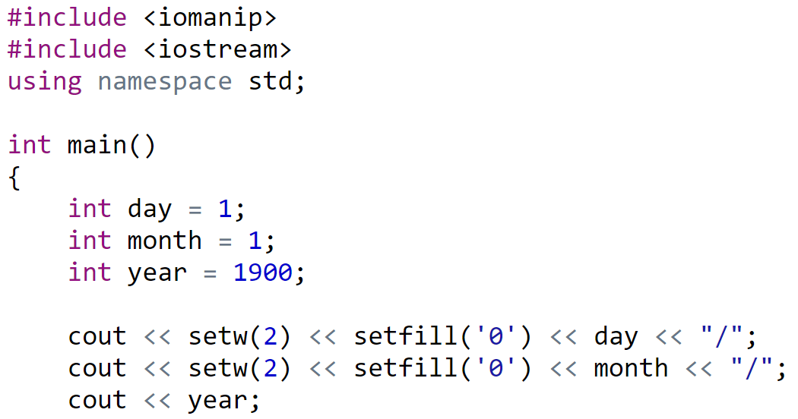

Padding when printing

Slide 53
Vector Dynamic array

Slide 54
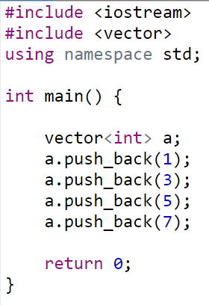

Create vector
How about bool, char, float vector?

Slide 55


Traverse vector – Just like normal array

Slide 56


Sort vector – Just like normal array

Slide 57
Remove an element of vector
erase(vector.begin() + i);

Slide 58
Exercise
Generate a random integer n (10 <= n <= 100)
Generate n random integers
Find & print out all prime numbers
Calculate the total sum of all these prime numbers
Calculate the average of all these prime numbers
Find the minimum and maximum prime numbers
Remove all odd numbers

Slide 59
Date time

Slide 60



Get current date time

Slide 61
Exercise
Get current date, then print out yesterday and tomorrow

Slide 62
Function template

Slide 63


Why do we need function template?
Suppose we have one function that can operate on int
How about string? Let’s write another function
How about char? float? double? Student? Product?....

Slide 64





Function template – Definition & usage

Slide 65


True meaning of function template
We think we only write code once
Actually, we borrow the power of compiler to generate the code below for us

Slide 66
Exercise
Create a sort function that can sort an array of any type in ascending order or descending order
Test it with int, string, Fraction, Student (based on GPA)

Slide 67
Working with text file

Slide 68

Reading Unicode file

Slide 69

Writing Unicode file

Slide 70

Change console font for displaying Unicode text

Slide 71
More on encoding
UTF8, UTF-18
BOM
Little-endian, big-endian

Slide 72
Static library
Reuse your code by organizing into static library

Slide 73

Some facts
Where are the actual code when you write
We knew iostream.h is just the header files
Where are the actual code?
And we only have one exe file after building
That exe file can be installed on another computer
So apparently the code from iostream library is embeded in our exe

Slide 74
General guidelines
Reference a static library is the most easy way to reuse your OOP code
You create a static library, the result will be
Header file (.h) contains the declaration
The .lib file, contains the implementation
Reference this library and then use it

Slide 75
Key idea
Static library is specifically used at compile time which means the library should be present in correct location when user wants to compile his/her C or C++ program
Which means when submitting your projects, remember to copy the static library together with your source code. (both .h and .lib file)

Slide 76
Creating static library & use it

Slide 77

Step 01 - Create a static library
Create a new project, type Static Library
Name it devlib (or choose a super duper name :) )
Disable Precompiled Header from project’s properties page

Slide 78


Add a devlib.h file and a devlib.cpp file
Of course we need two file, Header file .h and .cpp file
devlib.h devlib.cpp

Slide 79


Build project to see the artifact
In Debug folder we will see devlib.lib
This is the static library to use in other projects
To distribute the lib, we need to copy also devlib.h

Slide 80


Force copying .h to output folder
Right click on .h file > Properties
Select Copy File in Item type option (All configurations)
Now both .h and .lib is ready for distribution

Slide 81
Step 02 - Create another console project
Name it TestLib
Right-click on the application project node in Solution Explorer and then choose Properties.

Slide 82




Step 03
In the VC++ Directories, add path to LIB file in Library Paths, path to header file(s) to Include Directories.
In the Linker > Input property page, add the name of the LIB file to Additional Dependencies.

Slide 83

Step 04 - Start reusing code

Slide 84
Meaning
Every projects / solutions can use your library
Whenever the library is updated, all dependent projects will be automatically updated with latest version when rebuild
Remember to copy your library together with your source code for teachers to rebuild your project

Slide 85
Tuple

Slide 86

When returning one value is not enough
We create tuple to store multiple values

Slide 87

Accessing members of a tuple

Slide 88
Coding standard

Slide 89
Function
Start with verb
Avoid meaningless auxiliary like: do, act
Should have comment on
Purpose of the function
Return value
Parameters

Slide 90
if for do while switch
Add empty line before & after
Always use parenthesis even though we have one line of code

Slide 91
Constant comparison
Put constant first in comparison expression
if (200 == returnCode) then {
}

Slide 92
Further reading

Slide 93
Projects for inspiration
https://www.codewithc.com/c-projects-with-source-code/

